Slide 1

Syrian Private University
faculty of Information Engineering Telecommunication Engineering
First presentation of the semester project
Smart Satellite Transponder الذكي الفضائي البث إعادة جهاز
Prepared by: MHD.Nour Njeeb LaithAbdAlrazek
Supervisors: Dr.Nawaf Altawel Dr. Rawad Melhem
Date: 16/12/2025

Slide 2

OUTLINE:
_Project objective .
_Problem statement & importance.
_Implementation steps.
_Theoretical background.
_Implementation Smart Transponder Architecture.
_Baseband signal processing in satellites.
_Types of digital modulation techniques used in satellites
_Basic I/Q representation
_References.

Slide 3
1- Project objective:
Study and design of smart satellite transponder.

Slide 4


2_Problem statement & importance:
2.1_The Problem:
2.2_The Importance:
Traditional transponders have fixed functionality and cannot adapt to changes in data demand.
Inefficient use of bandwidth and transmission power.
Lack of flexibility in dealing with interference or unexpected conditions.
Meeting the growing demand for high-speed communication services (e.g., in-flight internet, maritime communications, remote areas).
Maximizing the return on the high cost of satellite launch and operation.
More flexible and efficient satellite communication networks.

Slide 5
3_Implementation steps :
Simulation of transponder model.
Development the model.
Study the fundamentals.
Practical design for the model.
Testing & development the model.

Slide 6
4_Theoretical Fundamentals :
Satellite Subsystems : Bus , Payload.
Satellite orbits: GEO, MEO, LEO, HEO.
Transponder types: Bent Pipe vs Smart (On-board Processing).

Slide 7
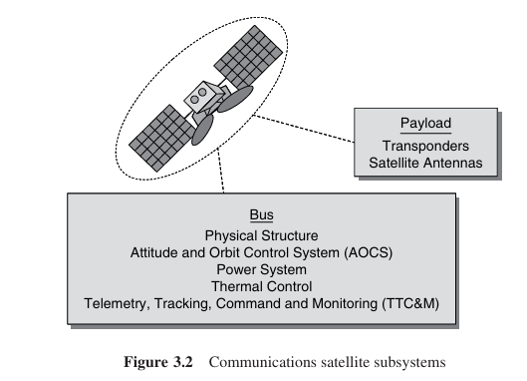
4.1-Satellite Subsystems :

Slide 8
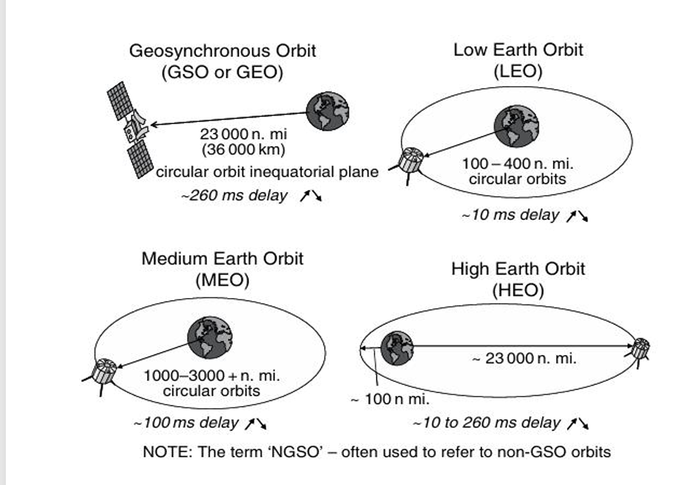
4.2_Satellite Orbits :
Form a_4.2

Slide 9
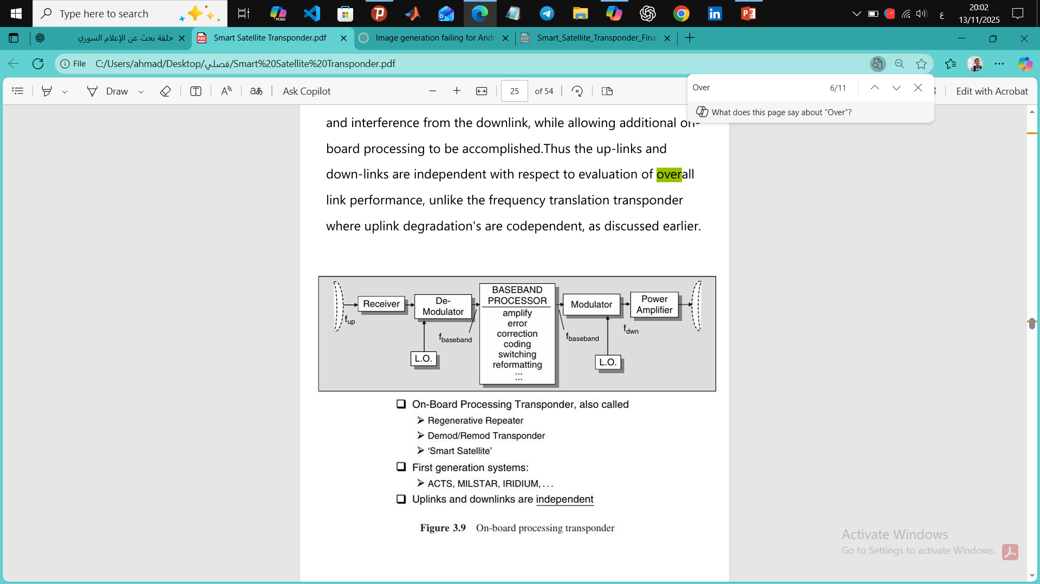
4.3_On-board Processing :
Form a_4.3

Slide 10

5_Baseband signal processing in satellites.
5.1_Definition of Baseband Processor:
It is a Digital Processing Unit that works on the signal after it has been dropped into the baseband, i.e., after the carrier has been removed.
5.2_Baseband Processor Location in the System:
Receive Path: Antenna → Demodulator → Baseband Processor.
Transmit Path: Baseband Processor → Modulator → Power Amplifier → Antenna

Slide 11
5.3_Its primary function is:
to process and improve digital data, correct errors, and reshape it before resending it.
5.4_The difference between Bent-Pipe and Baseband Processing.
Bent-Pipe Satellite | Baseband Processor Satellite
Amplify only | Intelligent processing
No debugging | Correction of errors
No switching | Switching
Simple | Complicated
Less delay | More delay

Slide 12
5.5_The importance of the Baseband Processor in modern satellite communications:
• Enable smart satellites.
• Support 5G NTN
• Increased spectral efficiency
• Improving Quality of Service (QoS)
• Reduce BER and Packet Loss

Slide 13
6_Implementation Smart Transponder Architecture :
Main Components & Architecture

Slide 14
6_Implementation Smart Transponder Architecture :
5.1_Main Components:
Duplexer
Band pass Filter
LNA
Mixer
IF Amplifier
IMUX
HPA
OMUX

Slide 15
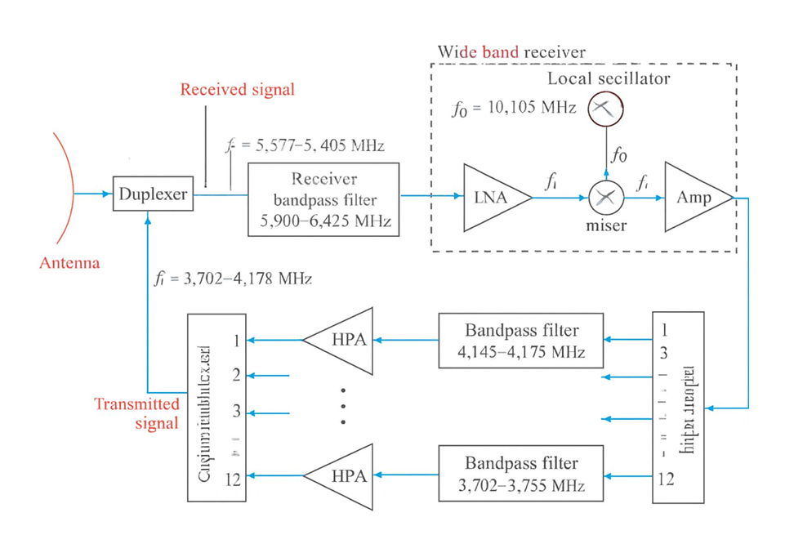
5.2_Transponder Architecture :
Form 1-3.2

Slide 16
7_Types of digital modulation techniques used in satellites
BPSK (Binary Phase Shift Keying).
QPSK (Quadrature Phase Shift Keying).
8PSK (8-Phase Shift Keying).
FSK (Frequency Shift Keying).
QAM (Quadrature Amplitude Modulation).
16-QAM
64-QAM
256QAM

Slide 17
8_Basic I/Q representation
The concept of I/Q (In-phase and Quadrature) representation is used as a basis for signal representation and efficient data transmission. This representation allows data to be transmitted at double the rate using limited bandwidth, making it the cornerstone of most digital wireless communications systems such as Wi-Fi, mobile phones, and digital broadcasting systems.
8.1_Mathematical basis:
Representing the signal using the two orthogonal components I (in phase) and Q (in quadrature) depends on the cardinality
s(t) = I(t)·cos(2πf₀t) - Q(t)·sin(2πf₀t)

Slide 18
Transmission path:
Divide data into symbols.
Convert symbols to I/Q values.
Pulse shaping via specialized filters.
Convert to radio frequency and combine the two components.
Receiving path:
Mix down to the fundamental frequency.
Separating and extracting the I/Q components.
Filter and sample.
Estimate the code and convert it to digital data.

Slide 19
8.2_Applications in satellite systems:
8.3_Importance in the smart rebroadcast device project:
Baseline Signal Processing: In OBP (On-Board Processing) modules.
Digital broadcasting systems: such as DVB-S2 .
High-speed communications: satellite Internet, 5G satellite communications .
Adaptive Modulation: Change the modulation scheme depending on channel conditions.
Intelligent on-board signal processing of the satellite.
Advanced error correction (FEC).
Dynamic switching between uplink and downlink.
Improving the spectral and energy efficiency of the system.

Slide 20
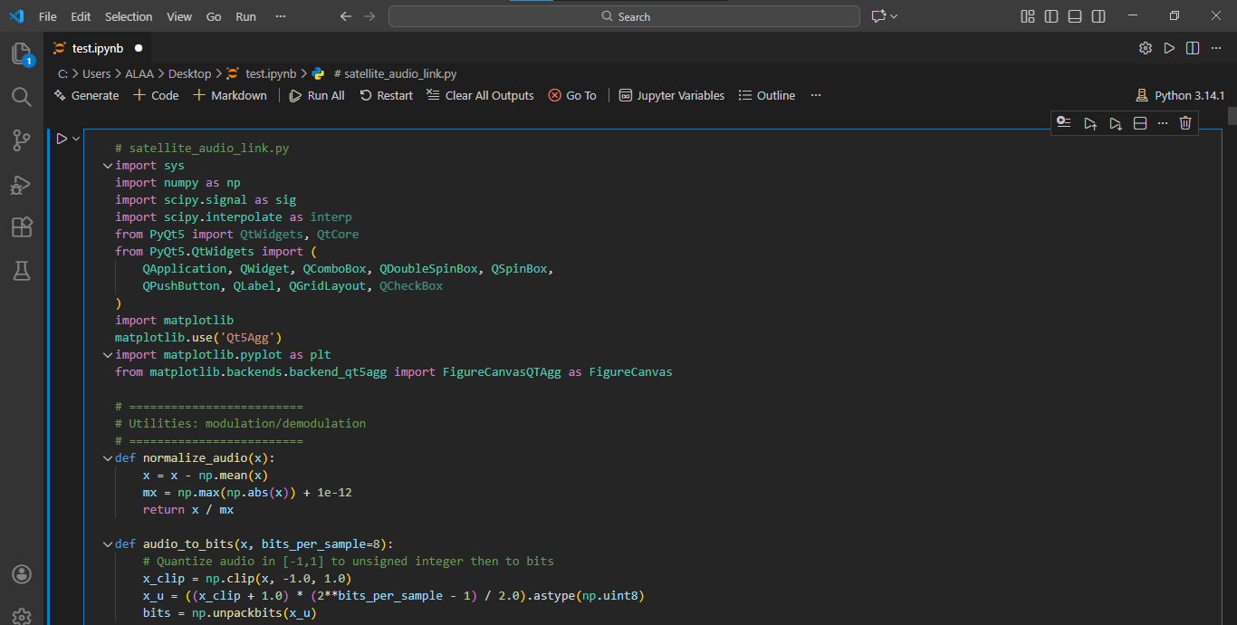

Slide 21
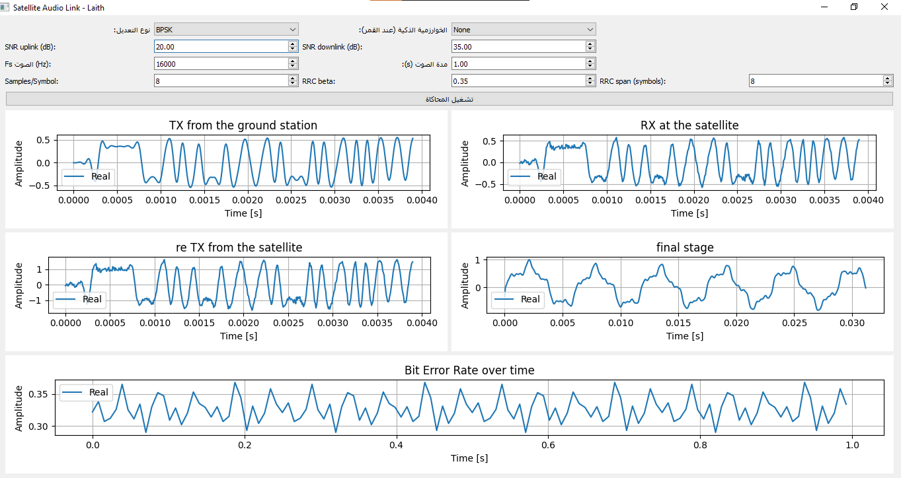

Slide 22
9- References:
1-Satellite Communications Systems Engineering Louis J. Ippolito, Jr.
2-E.Imboldi and D.Hershberg,‘Courier Satellite Communications System ,’Advances in the Astronautical Sciences, Vol. 8, 1961.
3-IEEE Transactions on Aerospace and Electronics Systems.
4-D.Roddy,Satellite Communications,Third Edition,McGraw-Hill,NewYork,2001.
5-T. Pratt, C.W. Bostian and J.E. Allnutt, Satellite Communications, Second Edition, John Wiley & Son, Inc., NewYork, 2003.

Slide 23
Thank You

